Slide 1
AR & VR Based Object Information Display Application
Advanced Topics in HCI
Prepared by: Ahmed Ibrahim and Khaled Amr
May 2026
Notes:
[Notes] Prepared for: Software Construction Enterprises [Sources] - (No external sources used; diagrams and content are original.)

Slide 2
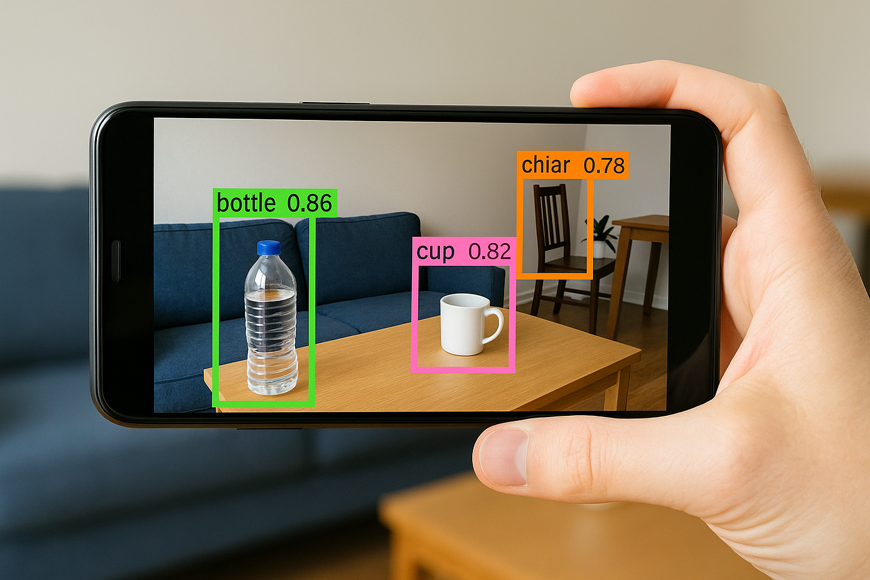
INTRODUCTION
Augmented Reality and Virtual Reality are important technologies in modern computer science.
They allow users to interact with digital content in a more visual and immersive way.
In our project, we focus on using Augmented Reality to display object information directly inside the real world.
The main idea is simple:
The camera views a real object
The application places a label above it
The label shows the object name or type
Later, the label can show extra details using AI and database integration
Example: A car appears in the camera view, and the app displays:
Notes:
[Notes] Prepared for: Software Construction Enterprises [Sources] - (No external sources used; diagrams and content are original.)

Slide 3
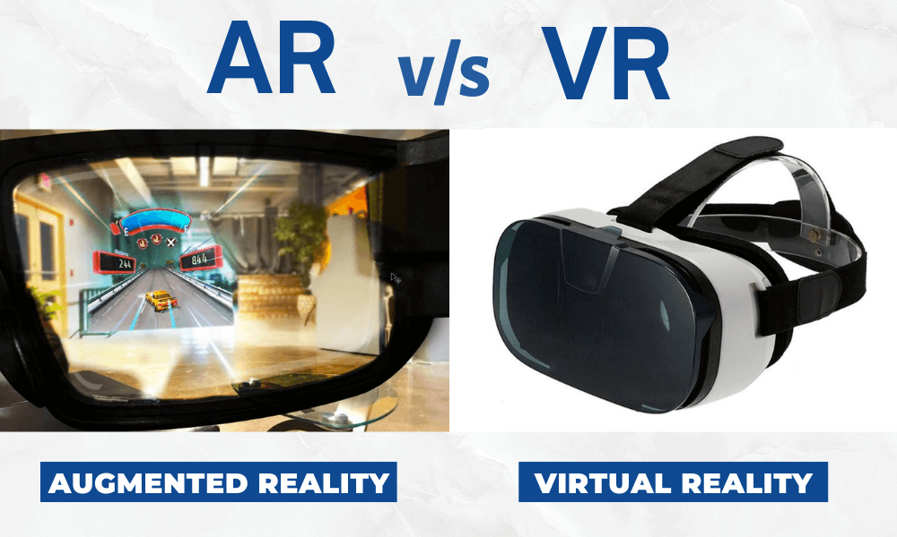
AR VS VR
AUGMENTED REALITY (AR)
VIRTUAL REALITY (VR)
Adds digital information to the real world
Uses mobile camera
User still sees real environment
Example: labels above objects
Creates fully virtual environment
Uses VR headset
Used in games and simulations
Notes:
[Notes] Prepared for: Software Construction Enterprises [Sources] - (No external sources used; diagrams and content are original.)

Slide 4
RESEARCH
Research Problem
We can make programming concepts more interactive and easier to understand.
EEG (Electroencephalography) was also used to measure:
Attention
Engagement
Learning effectiveness
Learning Approaches Evaluated
Paper-based Booklet – Traditional learning method (control group)
AR Application – Visualized Python data structures as interactive 3D objects
VR Application – Immersive environment for interacting with data structures
AI-Enhanced VR Application – Included an AI assistant for:
Real-time feedback
Personalized guidance
Student support
Engineering students often struggle with abstract programming concepts, especially Python collection data types:
Lists
Tuples
Sets
Dictionaries
Research Objective
The study explores how:
Augmented Reality (AR)
Virtual Reality (VR)
Artificial Intelligence (AI)
Notes:
[Notes] Prepared for: Software Construction Enterprises [Sources] - (No external sources used; diagrams and content are original.)

Slide 5
RESEARCH FINDINGS AND CONCLUSION
Major Findings
The study demonstrated a clear hierarchy in learning effectiveness, where the AI-enhanced VR application produced the strongest educational impact, followed by standard VR, then AR, while the traditional paper-based booklet showed the lowest level of student performance and engagement.
Students who used the AI-enhanced VR learning environment achieved the highest scores in the post-study comprehension assessments, showing statistically significant improvement (p < 0.05) when compared to the other learning methods used throughout the research.
EEG analysis revealed a strong relationship between mental engagement, attention levels, and academic performance, indicating that students who were more focused and immersed during the interactive sessions achieved noticeably better learning outcomes.
The integration of the AI virtual assistant provided students with personalized guidance, immediate feedback, and interactive support, which helped simplify difficult programming concepts and reduced the challenges associated with understanding abstract Python data structures.
Conclusion
The research concluded that the combined integration of Augmented Reality, Virtual Reality, and Artificial Intelligence created a highly interactive and transformative educational experience for engineering students. By converting abstract programming logic into immersive and interactive 3D visualizations, these technologies significantly improved student comprehension, increased engagement and motivation, and enhanced long-term knowledge retention when compared to traditional teaching approaches.
Notes:
[Notes] Prepared for: Software Construction Enterprises [Sources] - (No external sources used; diagrams and content are original.)

Slide 6
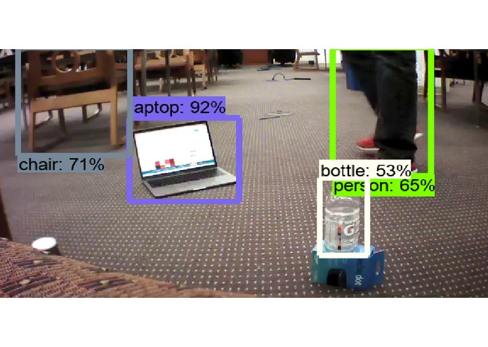
PROBLEM STATEMENT AND PROPOSED SOLUTION
PROBLEM STATEMENT
In many situations, users see objects around them but do not have enough information about them.
For example, a user may see:
A car and want to know its type or estimated price
A product and want quick details about it
An object and want to identify what it is
Normally, users must search manually for information using another application or website.
This makes the process slower and less interactive.
PROPOSED SOLUTION
Our project uses Augmented Reality technology to display information directly above real-world objects.
The application uses the mobile camera and AR technology to place digital labels inside the real environment.
.
Notes:
[Notes] Prepared for: Software Construction Enterprises [Sources] - (No external sources used; diagrams and content are original.)

Slide 7
SYSTEM WORKFLOW
The current prototype works using Augmented Reality technology.
Workflow steps:
User opens the application
Camera starts using AR view
The environment is scanned
User taps on a detected surface or object position
The system creates an AR anchor
A digital label appears above the selected position
The label stays fixed in the AR scene
Current displayed text: “This Chair”
This proves that digital information can be placed inside the real world using AR.
Notes:
[Notes] Prepared for: Software Construction Enterprises [Sources] - (No external sources used; diagrams and content are original.)

Slide 8
BENEFITS AND USE CASES
BENEFITS OF THE PROJECT
The application provides an interactive and modern user experience.
Main benefits:
Information appears directly above the object
Faster access to object information
Easy visual understanding
Interactive camera-based experience
Can be expanded using AI technologies
Can connect with external databases and APIs
Useful in many real-world applications
POSSIBLE USE CASES:
The project idea can be used in many fields such as:
Cars
Display type, condition, and estimated price.
Shopping
Show product names and details instantly.
Education
Help students identify objects and learn visually.
Museums
Display information about exhibits and historical objects.
Notes:
[Notes] Prepared for: Software Construction Enterprises [Sources] - (No external sources used; diagrams and content are original.)

Slide 9
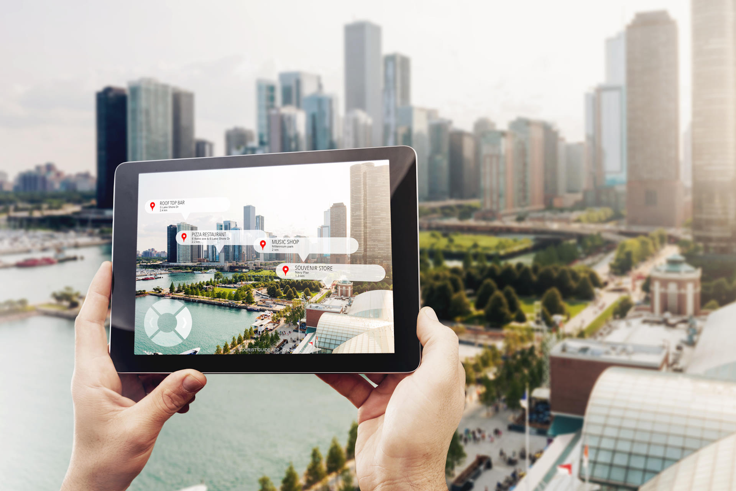
CONCLUSION
This project demonstrates how Augmented Reality can combine digital information with real-world objects.
The current prototype successfully places labels inside the AR environment.
The future version can integrate AI and databases to create a smart object information system.
Final idea:
Detect object → Get information → Display it in AR
The main goal of the project is to make the camera smarter and more interactive.
Notes:
[Notes] Prepared for: Software Construction Enterprises [Sources] - (No external sources used; diagrams and content are original.)

